Slide 1

Apache CouchDB
Midwestern State University
Avinash
Azhar
Madhu
Vishnu

Slide 2
Talking on these..
About CouchDB
NoSql Databases
Installation steps
Curl and Futon
HTTP API
Creating and Deleting Databases
Updating Databases – Basic operations
Using files in Databases

Slide 3
About Couchdb..
An open-source document oriented database
Created By : Damien Katz
Year : 2005
Language : Erlang
License : Apache Software Foundation(2008)
Type of DB: NoSQL Database

Slide 4
Erlang ?
Is a functional programming language, inspired by LISP, Prolog
Appeared first: 1986 (30 Years ago)
Recent stable release: 09/21/2016 (Less than 30 days ago) – 19.1
Initial Owner: Ericsson
Current Owner(Licensed to): Apache Software Foundations
Concurrency and distribution orientation of Erlang
8 Primitive data types
Tuples is one of them with 3 compound data types
One of these 3 is MAPS.

Slide 5
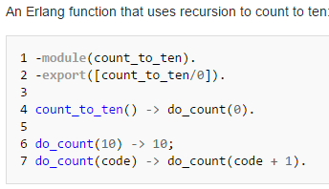
Erlang (Cont) – Functional Programming
FP treats computation as evaluation of mathematical functions
Code snippet:
Not talking much about functional programming.

Slide 6
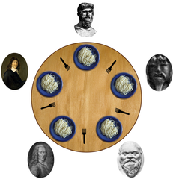
Erlang (Cont) – Concurrency and Distribution orientation
Consistent results, when concurrent programs are executed in-order or in partial order.
Example: Dining Philosopher’s problem.
Benchmark of 20 million processes were successfully performed.
Erlang uses “message passing” for communication.
Process distribution is done over multiple processors.
Parallel programming.

Slide 7

Erlang (Cont) MAPS
Why all this?
Helps understand CouchDB
MAPS – one of the compound data types in Erlang
Contain variable number of Key-Value associations.
Syntax: #{Key1=>Value1,...,KeyN=>ValueN}
2 ways to store data in Key-Value association:
Strings: doubly quoted lists of characters
ASCII codes used for characters in string
Example: “cat” -> [99,97,116]
Records: Indexing using tag element.
Useful for handling files.

Slide 8
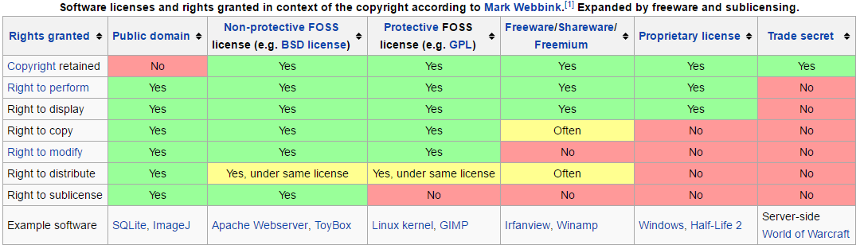
License? Apache Software Foundations
License: Legal instrument for use or redistribution of software.
FOSS – Free Open Source Software licenses.

Slide 9

Apache Software Foundations
Found: June 1999
Type: Non-profit corporation
All products are FOSS – Free open Source Software
Website: www.apache.org
Interesting fact: Google mentioned that 25% of 100,000 projects hosted on Google code were using Apache License, including Android OS.

Slide 10

NoSql Databases
Schema-Free
Distributed
Open Source
Horizontally Scalable
Easy Replication Support

Slide 11

Schema-Free.?
Do not require any modeling (3rd Normalization form)
Does not enforce data types
Models the business usage, rather than database schema, applications
Can store structured and unstructured data
Object Oriented format.

Slide 12

Distributed.?
Not all storage units are connected to the same CPU.
Data stored on multiple computers in same or different location.
Advantages:
Increased reliability and availability
Easier expansion
Protection of valuable data
Modularity
Improved performance
Disadvantages:
Complexity
Security
Analysis of distributed data

Slide 13

Open Source?
Source code of product is made available for:
Use
Modification
Open source products are available free of cost.
Open source is a certification owned by Open Source Initiative (OSI)
No restrictions can be applied on modified source code.

Slide 14
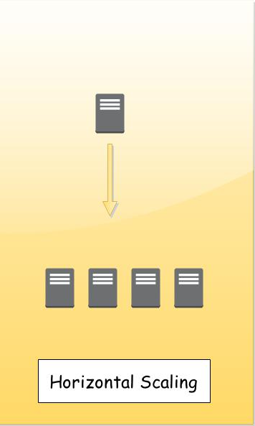
Horizontally Scalable.?
Ability to increase capacity by adding hardware or software entities.
Building out, instead of building up.
Advantage:
Don’t have to buy a new bigger server and move data, ADD a node
Handles high number of reads and writes
Disadvantage:
Database administrator needs to put all pieces together.
Adding cost effective servers is not a good idea.

Slide 15
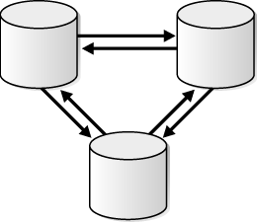
Easy Replication support?
Replication: Synchronizing multiple copies of same data.
Involves source and destination database.
Advantages:
Saves data loss
Increases speed of access
Data centers of significant companies:
Facebook: 9 copies of same data
Google: 17 across the world

Slide 16
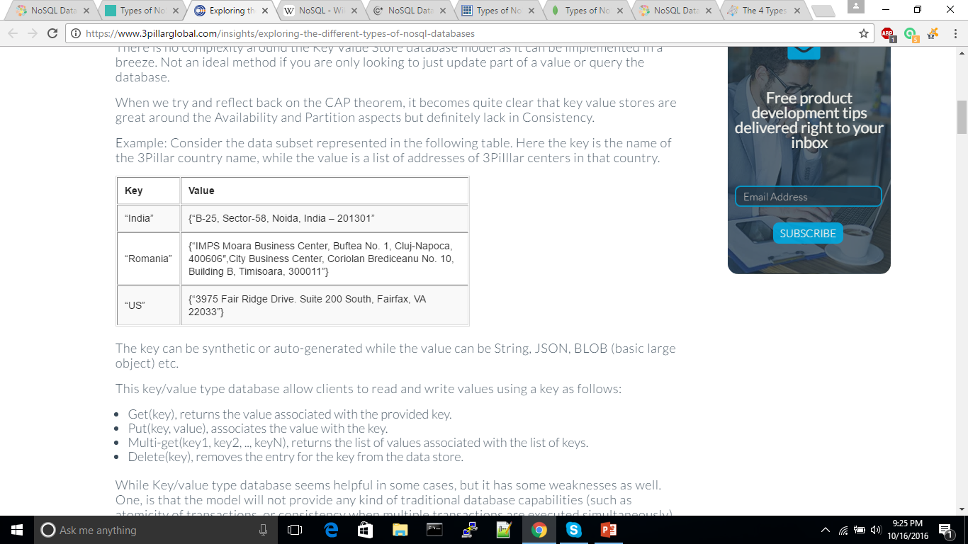
Types of NoSql Databases
Key - value stores:
Each data value consists of an indexed key and a value for that key
Examples − Berkeley dB, Cassandra
The key value type uses a hash table in which there exists
unique key and a pointer to a particular item of data.

Slide 17
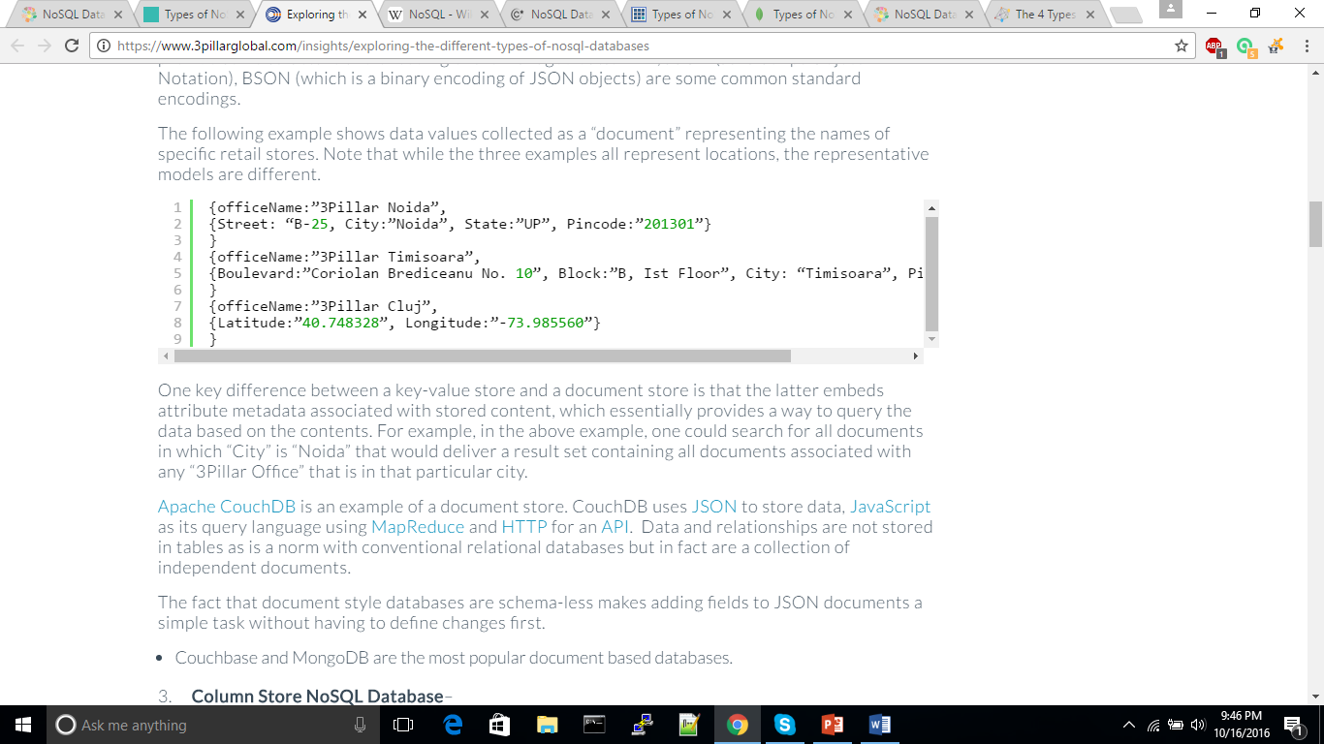
Document stores:
Data - a collection of key value pairs is compressed as a document store quite similar to a key-value store.
The only difference is that values stored referred to as “documents”.
Shows data values collected as a “document” representing the names of specific retail stores.

Slide 18

Document store
Data is stored in documents, rather than in tables.
Apache Couch DB is an example of a document store.
Couch DB and MongoDB are the most popular
document based databases.
API or query language that retrieves documents based
on their contents.

Slide 19
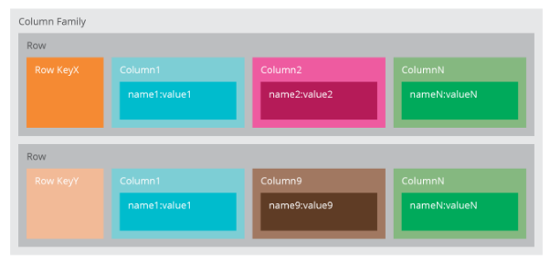
Column stores
Store data in column families as rows that have many columns associated with a row key.
Column family can be compared to a container of rows in an RDBMS table.
key identifies the row and the row consists of multiple columns.

Slide 20
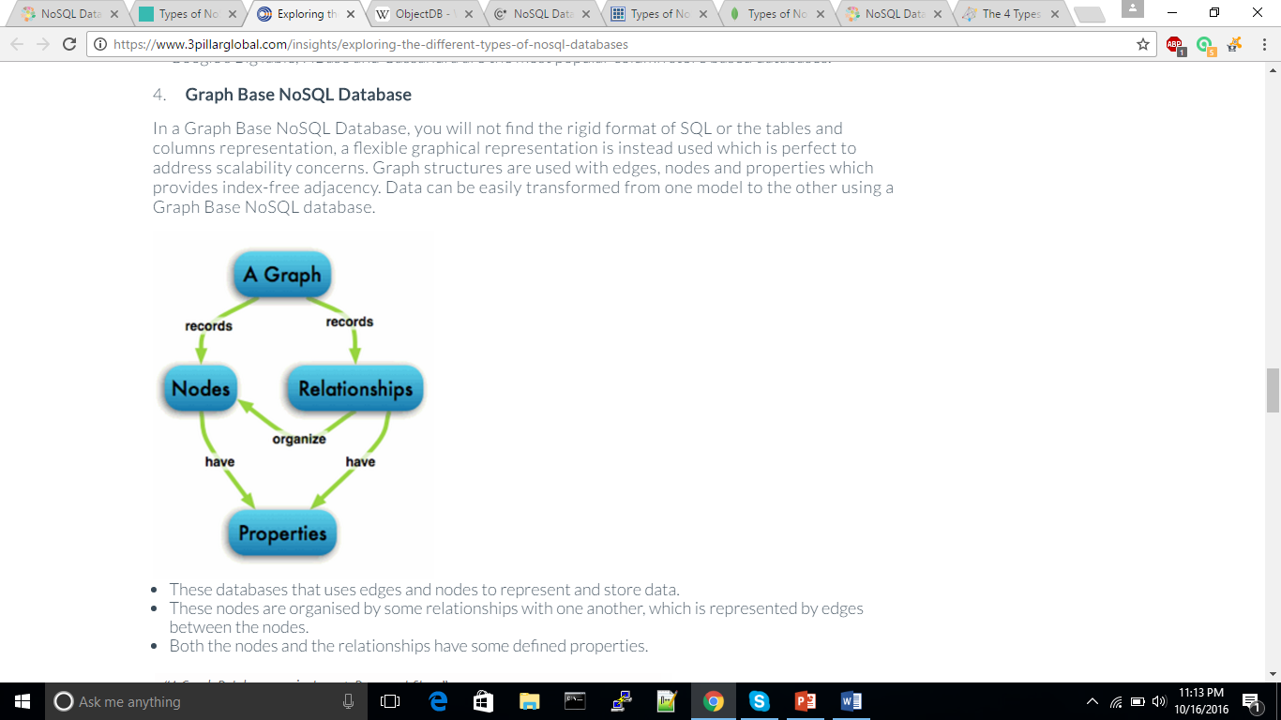
Graph base:
No SQL or tables or columns representation.
Graphical representation with nodes, edges & relationships between them.
Data can be easily transformed from one model to the other using a Graph Base NoSQL database.
Database uses edges and nodes to represent and store data.

Slide 21
SQL VS CouchDB
SQL | CouchDB
Relational | Non-Relational
Tables | Documents
Rows and Columns | Document Fields
SQL Query Engine | Map/Reduce Functions

Slide 22
Installing CouchDB
Download package;
1.6.1 Stable release
2.0.0 Latest release
Linux: sudo apt-get install couchdb – y
Windows: run the setup file
Need an installation demo?
Masters in Computer Science!

Slide 23
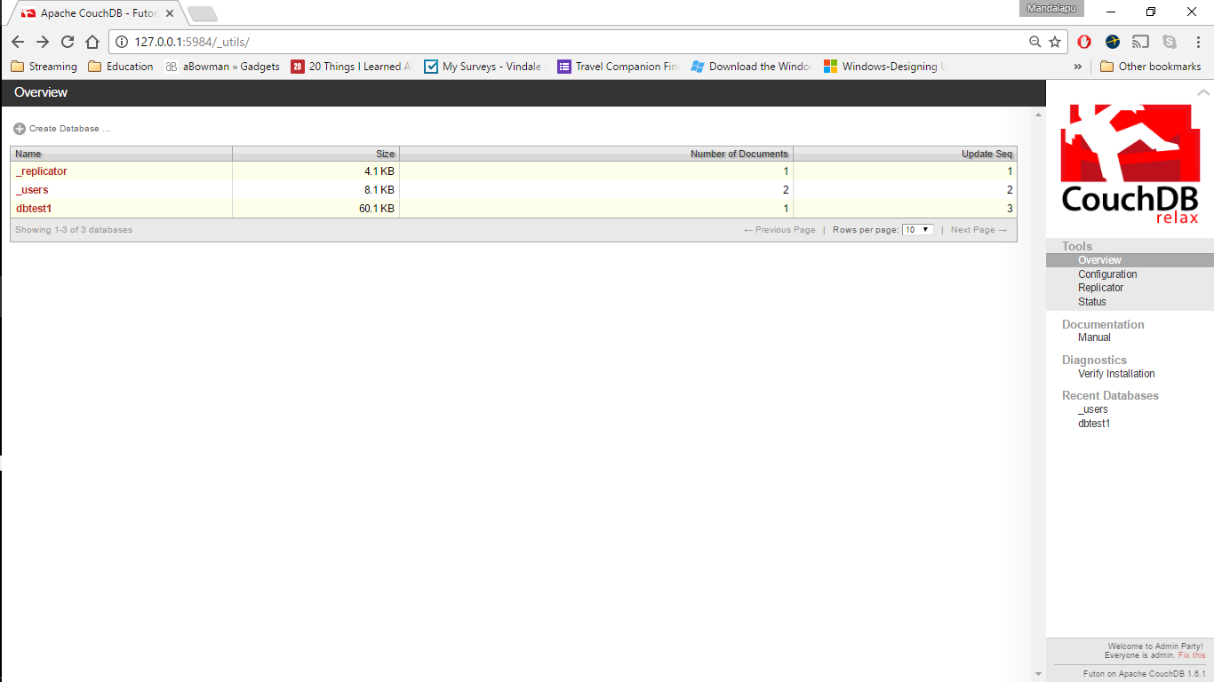
Why CouchDB
HTTP based REST API
No need to worry about structure of the data
Easy-to-use Replication

Slide 24
Features of CouchDB
Data Representation - Using JSON
Interaction - Futon / CouchDB API
Querying - Map / Reduce
Design Documents - Application code(Language : Javascript)
Documents can have attachments

Slide 25
JSON representation
Example:
{
"firstName": "John",
"lastName": "Smith",
"age": 25,
"phoneNumber": [
{
"type": "home",
"number": "212 555-1234"
},
{
"type": "fax", "number": "646 555-4567"
} ]
}
Stands for JavaScript Object Notation
Derived from JavaScript scripting language
Used for representing simple data structures and associative arrays

Slide 26
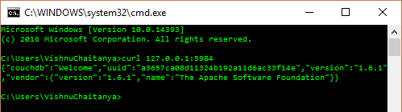
CURL – Transferring data using protocol
Checking to see if CouchDB server is up.
curl 127.0.0.1:5984
curl localhost:5984
curl server_ip:5984

Slide 27
CURL – Database API
Command to get a list of Databases :
curl -X GET http://127.0.0.1:5984/_all_dbs
Command to create a Database :
curl -X PUT http://127.0.0.1:5984/DB_name
Curl's -v option :
curl -vX PUT http://127.0.0.1:5984/DB_name
Command to destroy a Database :
curl -X DELETE http://127.0.0.1:5984/DB_name

Slide 28
CURL – Document API
Command to create a document :
curl -X PUT http://127.0.0.1:5984/albums/
6ert2gh45ji6h6tywe324743rtbhgtrg \ -d
'{"title":"abc","artist":"xyz"}'
Command to get a UUID :
curl -X GET http://127.0.0.1:5984/_uuids
Command to retrieve a Document :
curl -X GET http://127.0.0.1:5984/albums/
6ert2gh45ji6h6tywe324743rtbhgtrg

Slide 29
CURL – Document API
Command for attachments :
curl -vX PUT http://127.0.0.1:5984/albums/
6ert2gh45ji6h6tywe324743rtbhgtrg/ \
artwork.jpg?rev=2-2739352689 --data-binary
@artwork.jpg -H "Content-Type: image/jpg“
To view the image in the browser, URL is :
http://127.0.0.1:5984/albums/6ert2gh45ji6h6
tywe324743rtbhgtrg/artwork.jpg

Slide 30
CURL – Replicate API
Command to replicate a Database :
curl -vX POST http://127.0.0.1:5984/
_replicate \ -d '{"source":"albums","target":
"albums_replica"}'

Slide 31
FUTON
Built-in admin interface
Access to all CouchDB features
Create and Destroy databases
Create, View and Edit Documents
Compose and run Map / Reduce Views
Replicate a Database

Slide 32
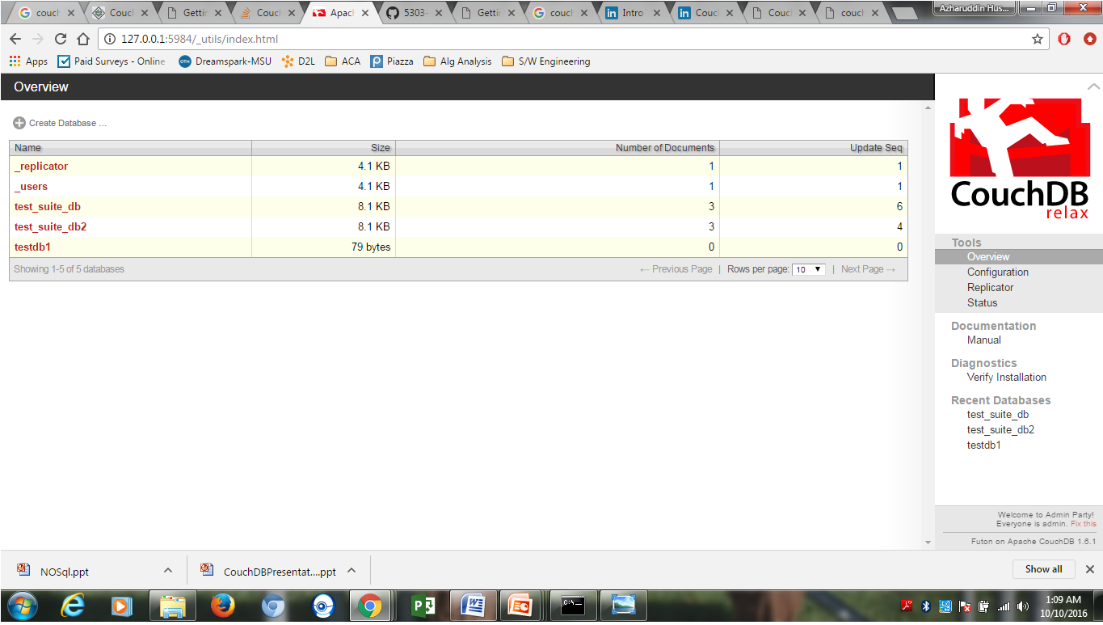
FUTON Interface Demo

Slide 33
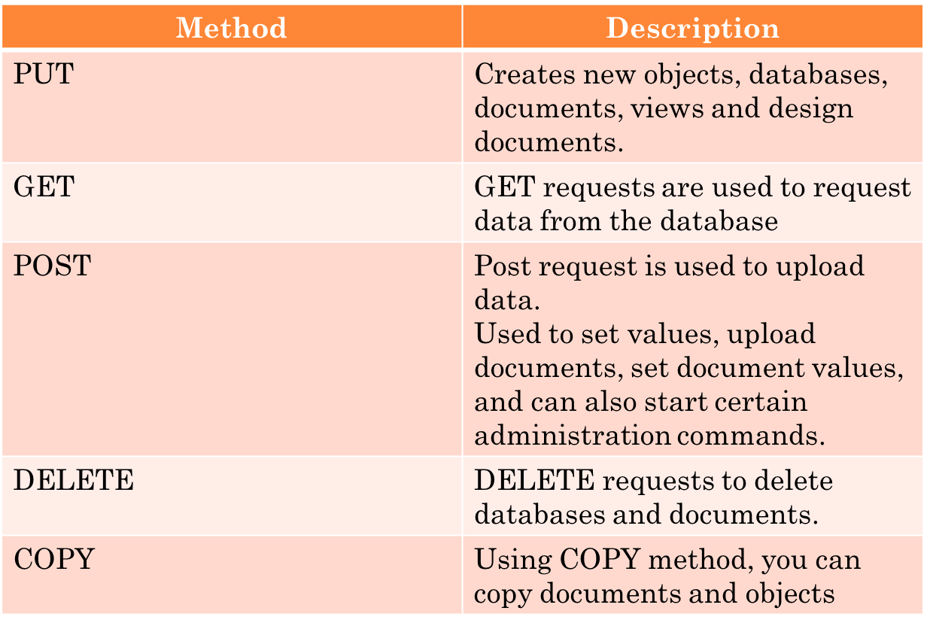
(HTTP API) HTTP Request Methods

Slide 34
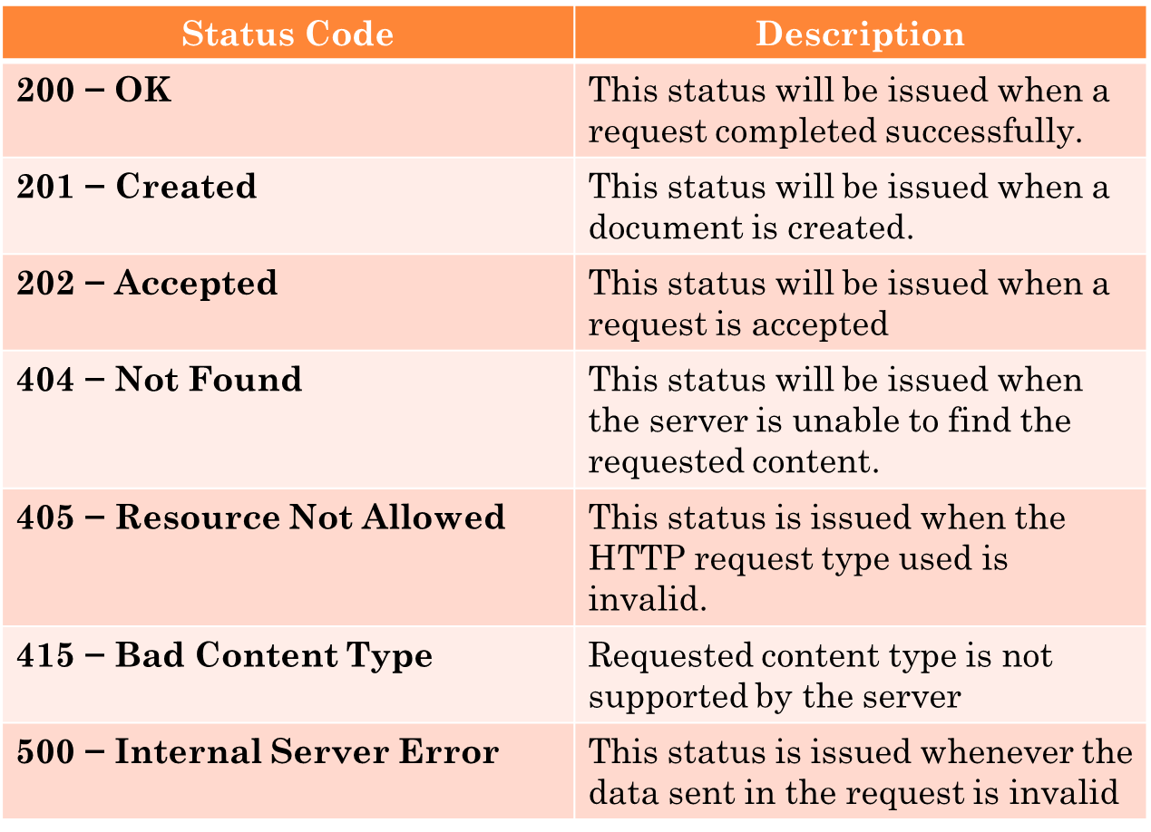
HTTP Status codes

Slide 35
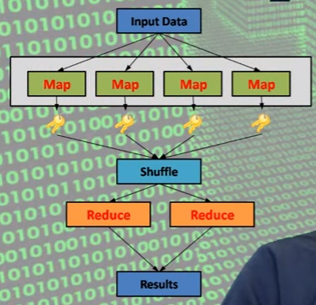
Map/Reduce in CouchDB
Map –Reduce is a technique designed for dealing with big data and processing in parallel in distributed systems
Designed to deal with semi-structured data
JavaScript (Default)

Slide 36
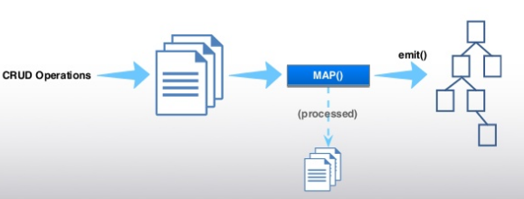
MAP Function
MAP functions identify data with collections, process them, and output transformed values

Slide 37
MAP Function
Has one document as input
Can emit all JSON _Types as key and value
Special Values: null , True, False
Numbers: 1.5, 200
Strings: “+”, “1”, “audi”
Arrays: [1], [1,2], [1, “Audi”, true]
Results are ordered by key

Slide 38
Reduce Function
Has arrays of keys and values as input
Should reduce the result of a map to a single value
Javascript
In CouchDB: Some simple built-in native erlang functions (_sum, _count)
Automatically called after MAP Function

Slide 39



Simple Map/Reduce Example
Considering the list of documents
Make a map, ordered by make
Result:

Slide 40


Simple Map/Reduce example
Result:
Write ‘sum’ – reduce
Result:

Slide 41


Array-key Map/Reduce example
List of cars (Documents)
Make a map, Array as key
Result:

Slide 42
Reduce / Rereduce
The input of a reduce-function does not only accept the result of a map, but also the result of itself.
A reduce function can be used more than once
Three built in reduce functions:
-> _sum
-> _count
-> _stats
If the map is too large, then it will split and each part runs through the reduce function, finally all the results run through the same reduce function again.

Slide 43
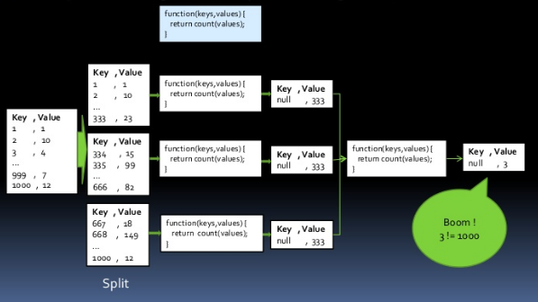
Reduce/ Rereduce
Example for Counting values..

Slide 44
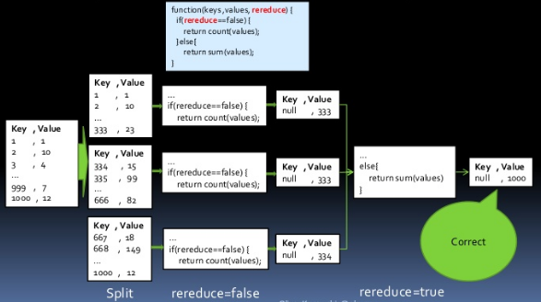
Reduce/ Rereduce
Using rereduce-flag

Slide 45
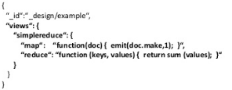

Where does Map/ Reduce live ?
Map /reduce functions are stored in a design document in the “views” key
Map/Reduce function start when a view is called

Slide 46
Thank you!
For being patient with us!

